Slide 1







PYEXPO25
Genius innovation leaves behind a legacy...
Team ID: T017
Team Name:Inno Ventures(
PS Number: PY044
PS Title: ASK YOUR VET
Domain:NLP
Category:Software
PYEXPO 2025
IPS TECH COMMUNITY

Slide 2
Problem Statement:
Farmers and animal owners often struggle with managing their animals' health because they may not have easy access to expert advice in their local language. They face challenges when they need to ask questions about diseases, symptoms, or other animal health issues, and may not know how to properly communicate their concerns.
Thus, developing a software to overcome these problem which mainly focus on farmers and pet owners looking to access quality healthcare of their animals.
PYEXPO 2025
IPS TECH COMMUNITY

Slide 3
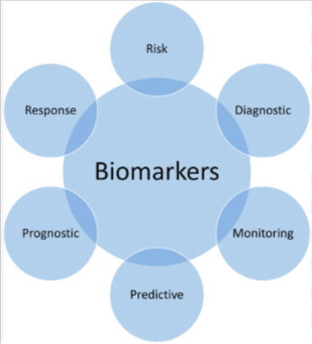
Proposed Solution and overview:
Solution:
The solution uses AI to help diagnose diseases quickly and accurately by analyzing symptoms provided by the user. It’s easy to access and gives instant support. It can also recognize diseases from pictures of animals, making it simple for farmers to upload images and get help. Plus, it creates personalized care schedules for animals based on their age and species.
Overview:
This system streamlines animal healthcare by providing efficient tools for diagnosis and care management, ensuring improved accuracy and accessibility for users.
PYEXPO 2025
IPS TECH COMMUNITY

Slide 4
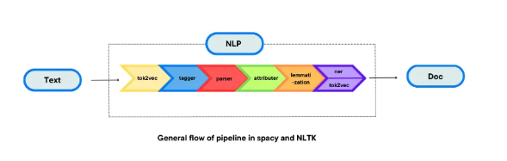
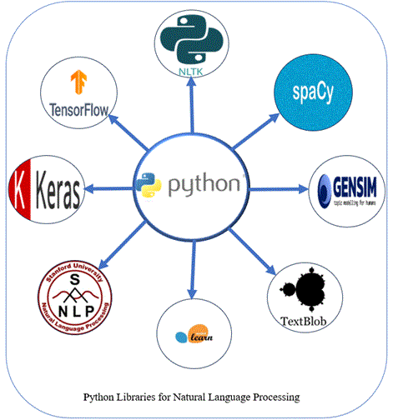
Data And Model :
A multilingual veterinary consultation platform using NLP-powered query processing for faster expert responses via handheld devices.
Users & Roles:
Animal Owners: Submit text, voice, or image queries in local languages.
Experts: Vet Surgeons, Gynecologists, Livestock Inspectors, AI Workers.
Admins: DAHO, AD, Taluka VO manage authentication & operations.
NLP-Driven Features: Speech-to-Text & Multilingual NLP for query processing.AI Categorization & Smart Response Suggestions for experts. Image Recognition for disease detection.
Privacy & Security: OTP authentication, AI spam filtering, and encrypted data storage.
Tech Stack: Google NLP, TensorFlow, OpenCV, Firebase, PostgreSQL.
Tools:
Text & Speech Processing – spaCy, NLTK, BERT, Whisper (OpenAI) for query understanding.
Query Categorization – Google Cloud NLP, Dialogflow, FastText for intent detection.
Image & Video Processing – Tesseract OCR for text extraction, OpenCV + TensorFlow for disease detection.
AI Search & Recommendations – Haystack, ElasticSearch for smart search.
PYEXPO 2025
IPS TECH COMMUNITY

Slide 5
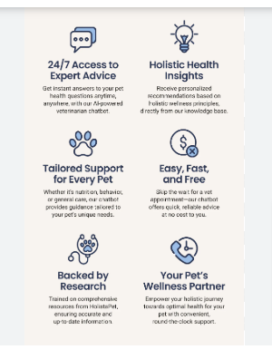
Impact and Benefits:
Impacts: Farmers and animal owners gain instant access to experts, ensuring faster disease identification and effective treatment.
Benefits: Improved animal health leads to increased productivity and higher farm income, while early detection helps prevent the spread of diseases.
Ethical Considerations & Real-world Applications:
Ethical consideration:Ensure privacy, secure communication, and informed consent for data use. Experts must provide accurate advice and recommend in-person visits when needed. Ethical practices build trust and reliability.
Real World Application:Early detection and treatment help you to stop diseases from spreading , keeping animals healthier and saving farmers from big losses. By getting online advice, farmers can avoid unnecessary trips to the vet, making animal care more economical and convenient.
PYEXPO 2025
IPS TECH COMMUNITY

Slide 6
Team Member Details:
NAME ROLL NO: DEPARTMENT
Zuvairiya shifa.S(TL) 24UCY163 CYS
Shri Vathsa.M 24UCY150 CYS
Rohith.S 24UCY143 CYS
Swetha.G 24UCY156 CYS
Santhiya.A 24UCY148 CYS
Rithish.S 24UCY142 CYS
PYEXPO 2025
IPS TECH COMMUNITY

Slide 7
THANK YOU !

